Slide 1
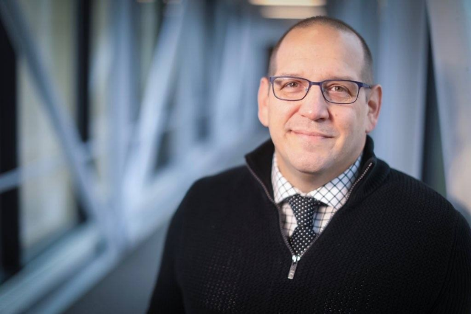
“To Grad School or Not to Grad School”
…Is It A Question?
presented by:
Jason Vignone
Director of Graduate Admissions and Retention
jvignone@govst.edu

Slide 2
Opens Doors to a New Career
Careers Requiring a Master’s Degree
-Psychologist
-Education Administrator
-Mental Health Counselor
-Political Scientist
Careers Requiring a Doctoral Degree
-Physical Therapist
-Occupational Therapist
-College Professor

Slide 3
Increase Earning Potential
-Individuals with a Master’s Degree have an average starting salary of $64,510.
-Individuals with a Doctoral Degree have an average starting salary of $97,550.
*Bureau of Labor Statistics, 2013

Slide 4
Why GSU?
Affordable Tuition
-The average cost of tuition for a public university in Illinois is $8,143.33 compared to $6,696.00 at GSU – saving you 17.8%*
Award Winning Faculty
-Our faculty come from some of the world’s leading universities including Northwestern University, NYU, and University of Chicago.
-From Professor Fraud to Emmy-Award winners the GSU faculty are leaders in their fields.
*Based on full-time / full-year tuition from collegesource.net

Slide 5
College and Programs – (Masters)
College of Arts and Sciences
- Master of Arts English
- Master of Art in Communication, Media, and Performance
- Master of Art in Public Administration
- Master of Art in Political and Justice Studies
- Master of Art in Criminal Justice
- Master of Fine Art in Independent Film
- Master of Fine Art
- Master of Science in Information Technology
- Master of Science in Computer Science
- Master of Science in Analytical Chemistry
- Master of Science in Environmental Biology
- Master of Science in Mathematics
- Master of Science in Mathematics – Teacher Education

Slide 6
College and Programs – (Masters)
College of Business
- Master of Business Administration (In-Person and Online)
- Master of Science in Accounting
- MBA in Supply Chain Management
- Master of Science in Business Analytics
- Master of Science in Human Resource Management
College of Education
- Master of Arts in Education Administration
- Master of Arts in Special Education
- Master of Arts in Early Childhood Education
- Master of Arts In Counseling
- Master of Arts in Psychology
- Education Specialist

Slide 7
College and Programs – (Masters)
College of Health and Human Services
- Master of Health Science in Communication Disorders
- Master of Health Science in Addictions Studies
- Master of Health Administration
- Master of Science in Health Informatics
- Master of Science in Nursing
- Master of Occupational Therapy
- Master of Social Work

Slide 8
College and Programs – (Doctoral/Certificates)
Doctoral Programs
- Doctor of Education in Interdisciplinary Leadership
- Doctor of Education in Counseling and Supervision
- Doctor of Nursing Practice
- Doctor of Physical Therapy
Certificates
- Bilingual/Bicultural Education
- Online Teaching
- Biology/Chemistry/English/Math Education
- Early Childhood Education
- Data Analytics
- Digital Forensics
- Family Nurse Practitioner

Slide 9
Funding Graduate School
Federal Aid
-Federal Student Loans are available to those who qualify through the Free Application for Federal Student Aid (FAFSA)
Scholarships
-There are many scholarship opportunities through the GSU Foundation and outside institutions available to Graduate Students.
Graduate Assistantships
-GSU has numerous Graduate Assistantships available that cover between 6-9 hours of tuition and may also include a stipend of up to $600 dollars a month.

Slide 10
Graduate Assistantships
- Usually cover Tuition (amount varies)
- You will be expected to work/teach in the college or university.
- Assistantships often include a stipend in addition to the tuition waiver.

Slide 11
Graduate Assistantships
- Governors State has numerous Graduate Assistantships available.
- Graduate Assistantships at GSU cover between 6-9 credit hours per term.
- At GSU the average Graduate Assistantship includes a stipend between $450 - $600 per month.
- GA positions are listed on the graduate studies page www.govst.edu/grad-assistant/ and on the Jobs for Jaguars link on our Career Services page www.govst.edu/careerservices/

Slide 12
Admission Requirements
Master’s Admission Requirements
All applicants must:
-Have earned (or will have earned by the term they wish to enroll) a bachelor’s degree from a regionally accredited college or university.
-Have been in good standing at the last institution attended.
-Have satisfied collegial and/or major criteria, if applicable, for graduate study in a specific major.
-Submit official transcripts from all previously attended institutions demonstrating a fulfillment of the above three items) to the office of admissions.
Doctoral Admission Requirements:
Governors State University’s doctoral programs have varied requirements for admission: check the GSU Catalog for specific admission requirements, application forms, deadlines, and required materials.

Slide 13
Ways to Connect
Direct Link: www.govst.edu/admissions/
Spanish Language Virtual Appointments Available

Slide 14
apply.govst.edu/apply
OH111420
Jason Vignone
Director of Graduate Admissions and Retention
jvignone@govst.edu

